Slide 1
NBAC
May 21, 2026
Co-Chairs:
Kamran Atri Thomas Krul Paul Wormeli
Notes:
Welcome – Introduction.

Slide 2

NIEMOpen is:
An open source framework
for building a consensus on
data standards that facilitate
information sharing
across domains
and internationally

Slide 3
AGENDA
1:00 Opening and NIEMOpen general update—Paul Wormeli
1:10 Progress report on the initiation of the forensics domain—Ryan Triplett
1:20 Report on the NTAC NIEMOpen Toolset gaps and recommendations—Brad Bolliger
1:30 Exploring collaboration with the Basic Formal Ontology (BFO)—Brad Bolliger
1:40 Developing data standards for countering drone technology—Michael Simcock
1:50 Discussion of a potential new domain on financial integrity—Paul Wormeli/Thomas Krul
2:00 Adjourn
3

Slide 4
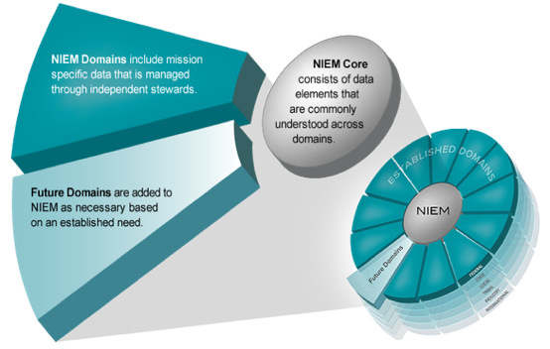
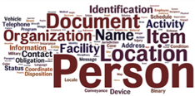
NIEMOpen Model Content
Think of the NIEMOpen data model as a mature and stable data dictionary of agreed-upon terms, definitions, and formats independent of how information is stored inside individual IT systems.
NIEMOpen has 19 Domains
Agriculture
Biometrics
Chemical, Biological, Radiological, & Nuclear
Cyber
Emergency Management
Human Services
Immigration
Infrastructure Protection
Forensics
Intelligence
International Trade
International Human Services
Learning & Development
Justice
Maritime
Military Operations
Screening
Surface Transportation
Analytical Laboratories
Notes:
Let’s take a look at a basic example of the NIEMOpen core and the NIEMOpen domain relationship.
All domains would agree that a person has a name and date of birth—commonly agreed-upon characteristics of a person.
Some communities have a business need to extend the definition of a person based on their information exchange requirements. For example, within the Justice community, they need the flexibility to extend Person to capture additional information of a Subject, who may be involved or suspected of being involved in an incident or criminal activity. In addition, a name and date of birth are not sufficient to identify a Subject. They also may require biometric identifiers such as fingerprints, scars, or tattoos to verify their identity.
Another commonly used core element is Activity. For example, the Cyber Domain may need to extend Incident such as a breach event to include additional identifiers such as IP Address or Type to create context.

Slide 5






UNCLASSIFIED
Forensics Sub-Committee
Status Update
05.22.2026
UNCLASSIFIED

Slide 6
History & Progress
COMPLETED ACTIVITIES
Forensics Domain formally established in Spring 2025
Subcommittee Kick-Off Town Hall held in December 2025
Publication of an article in Journal of Forensics Research and a NIEMOpen press release
Forensics Subcommittee GitHub page for collaboration: https://github.com/niemopen/niem-forensics
Forensic attributes lists, rosters, and meeting documentation posted to GitHub
CURRENT ACTIVITIES
Tiger Teams
  Subcommittee leadership is conducting meetings with forensic organizations and subject matter experts to identify leads
  Tentative lead identified for Chemistry tiger team – awaiting confirmation
Subcommittee Documentation
  Draft SOP/Guidance document for tiger team leads under review
  GitHub page is being updated as new subcommittee documents are developed
UNCLASSIFIED

Slide 7
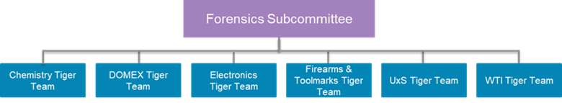
next steps
TIGER TEAM DEVELOPMENT
Timeframe: Ongoing
Process:
  Leadership will meet with tiger team leads as they are identified
  Leads will work with their tiger team to begin attribute refinement and development
GENERAL SUBCOMMITTEE MEETING
Timeframe: Fall 2026
Topics:
  Introduction of tiger team leads
  Status updates on tiger teams and attribute development
  Overview of GitHub page
UNCLASSIFIED

Slide 8
NTAC Updates for May 2026 NBAC Call

Slide 9
NTAC Tool Expansion and Ontology Support
NTAC is exploring BFO/CCO–NIEM value and use cases
  The goal is to highlight the business value of using BFO and CCO in conjunction with NIEM
  Outputs include demonstrating potential use cases and opportunities, e.g.:
    DHS/DOD collaboration,
    Ontologies for inference in NIEM-enabled environments more generally,
    and possibly NIEM expansion, if domain ontologies provide new insight or opportunity.
NTAC Tooling Tiger Team discussion and recommendations
  Tooling Tiger Team has recommended expanded support for new developer tools (e.g., MCP server, broader support for Semantics, CMF SQL outputs, and other tool improvements)
  We discussed the importance of user workflow(s), mapping templates, and accommodating new user personae - especially those who expect AI or ontologies to help them use NIEM more easily
Critical of note for the NBAC:
  This will require successful completion of the API 2.0, and revised Training and Workflows (i.e. MEP)

Slide 10
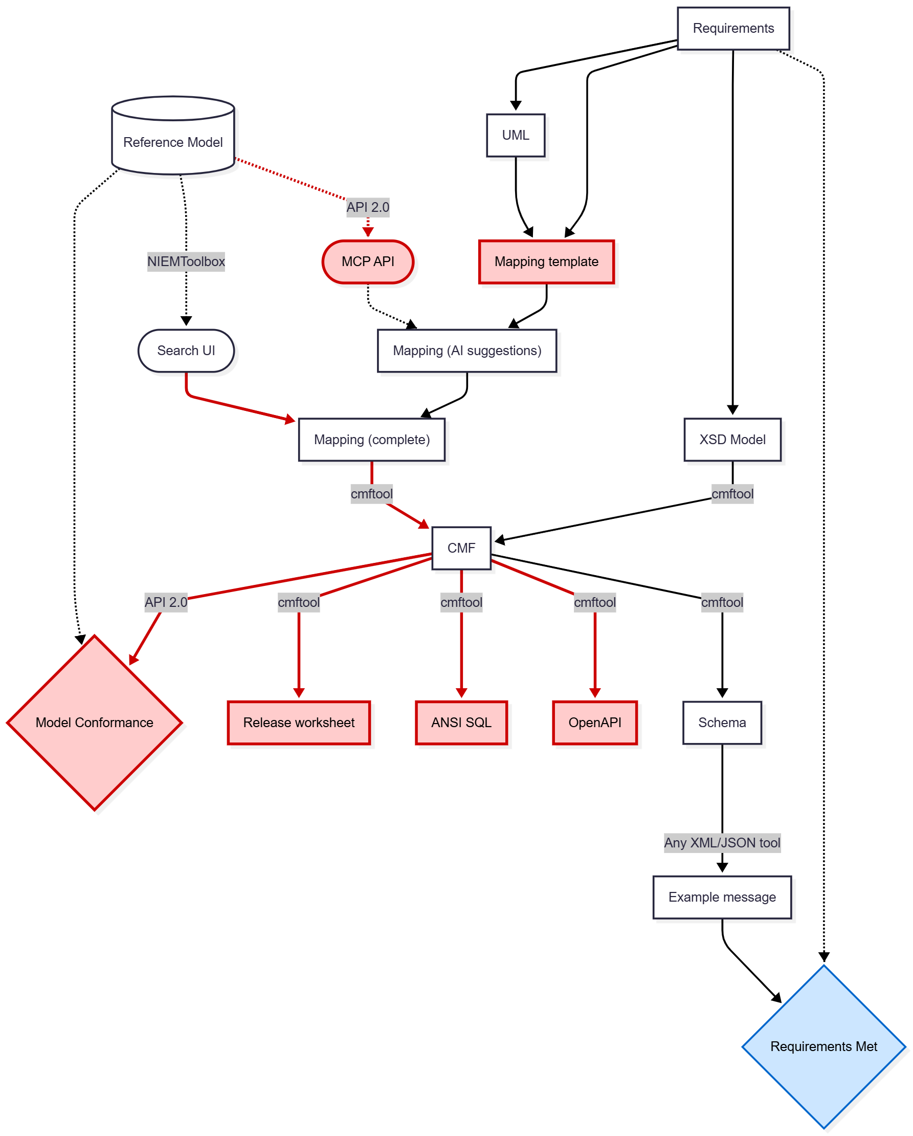
NIEMOpen Tools
Recommendations
Standardized mapping templates
  Message specifications
  Releases/domain updates, and other aspects of NBAC support
CMFTool enhancements
  Document how to use (in progress)
  Test XML/JSON interoperability (in progress)
  Import message mappings
  Export ANSI SQL, OpenAPI and release worksheet
API 2.0/NIEMToolbox enhancements
  Save mappings in Search UI
  Expose a Model Context Protocol (MCP) API
    (to enable third party AI tools)
  Validate Model Conformance of a CMF

Slide 11
Other NTAC conversation or discussion relevant to NBAC
DAMA-DMBOK 3.0 workshops
  DAMA is planning an expansion of DMBOK, and we hope this will include mention of NIEM
  NTAC co-chairs are planning to attend May workshop, scheduled next Wednesday, May 27th
Other NTAC conversation or discussion relevant to NBAC:
  Coordinating a NIEM user survey with support from IJIS,
  Discussing website updates, including but not limited to SSGT, expanded Success Stories, and a streamlined communication of NIEM’s value to Government and Commercial users
  Anticipating NTAC support of the ISO certification process, hoping to discuss in June 2026

Slide 12
Update on Counter-UAS information standards
12
The emerging data standard for Counter‑UAS (C‑UAS) activities is being driven primarily by a U.S.–U.K. initiative to create a unified, interoperable data format for detection, tracking, and engagement of unmanned aerial threats. Purpose of the Standard:
Create common data formats for C‑UAS sensors, effectors, and command‑and‑control systems to transmit their findings
Improve sensor fusion, allowing multiple radars, RF detectors, EO/IR cameras, and effectors to share a unified picture
Enable interoperability between U.S. and U.K. systems, with potential expansion to NATO partners.
Reduce and enhance the C2 operator workload for interpreting and engaging UAS threat contacts
What Counter UAS data and information sharing standards have been developed so far?
NATO is in the process of adopting the UK-Developed SAPIENT (Sensing for Asset Protection with Integrated Electronic Networked Technology) approach
  SAPIENT Plug and Play approach is to enhance vendor products in order to process raw data and transmit standardized information exchange messages between components
  Utilize AI for processing and interpreting raw data for detecting, identifying and confirming UAS contacts
  Demonstrated and tested Counter UAS systems that integrated SAPIENT plug-and-play software engine
  UK MOD has developed an Interface Control Document (ICD) for SAPIENT integration
DOD and DHS have decided to adopt the NATO approach to maintain uniformity and key alignments with other countries implementing Counter UAS strategy. This includes:
  Open Architecture and interoperability
  AI and autonomous functionality
  Operational efficiency
  Plug-and-Play Implementation strategy with hardware vendors (NATO and US Army)
Notes:
Implementation strategies to date
Ukraine has not tested or integrated NATO approach but continues to rely on operator interpretation of raw data
NATO is still finalizing adoption of C-UAS standard (STANAG 4315) with partner countries
US Army is implementing the UK-DoD approach at the Corp unit level for C-UAS vendor purchases
DHS has separate implementation approach with Federal partners and States Grant money for States to implement C-UAS solutions is in 2026 and 2027 budget

Slide 13
Potential financial integrity domain
13
Support for information exchanges to counter fraud, waste and abuse
Scope could include contracts, grant management, beneficial ownership
Reuse of community-agreed data models, with local extensions
A technology-neutral data modeling language compatible with ontology formalisms
Knowledge graph representation of exchanged data
Automated conversion between supported serializations (XML to JSON, etc.)
Machine validation of message specifications for NIEM conformance
Machine validation of exchanged data for message specification conformance
Notes:
Another point to highlight is that you may be using NIEMOpen and not even know it.
NIEMOpen has been incorporated and leveraged by several other industry standards as identified on this slide. If you are currently using any of these standards, you are technically using NIEMOpen as well.

Slide 14








NIEMOpen Current Sponsors
8 Sponsors, 2 Premier
Sponsors
Bright Query
DHS S&T
CJIS (FBI)
GTRI
NAJIS
IJIS
Senzing
SEARCH
Premier
Premier
Potential Sponsors
Federal agencies
State and local agencies
Private Sector
Non-governmental agencies
International agencies

Slide 15








resources
Follow Us On Twitter
https://twitter.com/NIEMconnects?ref_src=twsrc%5Etfw
Katherine Escobar, katherine.b.escobar.civ@mail.mil, 7575-203-8631
Beth Smalley, beth.l.smalley.civ@mail.mil, 757-203-7177
https://www.niem.gov/
https://niemopen.org/
https://www.linkedin.com/groups/1903175/profile
Git Repos
  NIEMOpen: https://github.com/niemopen/
  NTAC TSC
    https://github.com/niemopen/ntac-admin
  NBAC TSC
    https://github.com/niemopen/nbac-admin
  NMO TSC
    https://github.com/niemopen/nmo-admin
    https://github.com/niemopen/nmo-training
  NIEMOpen Slack Channel: https://niemopen.slack.com/
Mailing Lists
  NIEMOpen: https://lists.oasis-open-projects.org/g/niemopen
  PGB: https://lists.oasis-open-projects.org/g/niemopen-pgb
  NTAC TSC: https://lists.oasis-open-projects.org/g/niemopen-ntactsc
  NBAC TSC: https://lists.oasis-open-projects.org/g/niemopen-nbactsc
  NMO TSC: https://lists.oasis-open-projects.org/g/niemopen-nmotsc
https://www.youtube.com/channel/UCg9qV22PXLBjG41hc-EwVrQ
MEP Registry & Repository
Restricted Repository-WMAAFIP
NIEM Message Exchange Package Builder

